Slide 1
SIGN-ify
Empowering Hands, Innovating Gestures
Notes:
Kota

Slide 2
>18,000,000
People with Hearing-Impairment in INDIA
Notes:
Kota

Slide 3
INTRODUCTION
This project proposes the development of a wearable glove that translates sign language into text and speech in real-time. The goal is to bridge the communication gap between the deaf and hard-of-hearing community and the hearing community, improving communication and integration.
Notes:
Kota

Slide 4
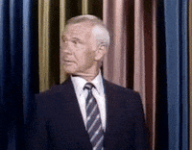
PROBLEM STATEMENT
The communication gap between the deaf and hard-of-hearing community and the hearing community needs to be bridged.
Notes:
Kota

Slide 5
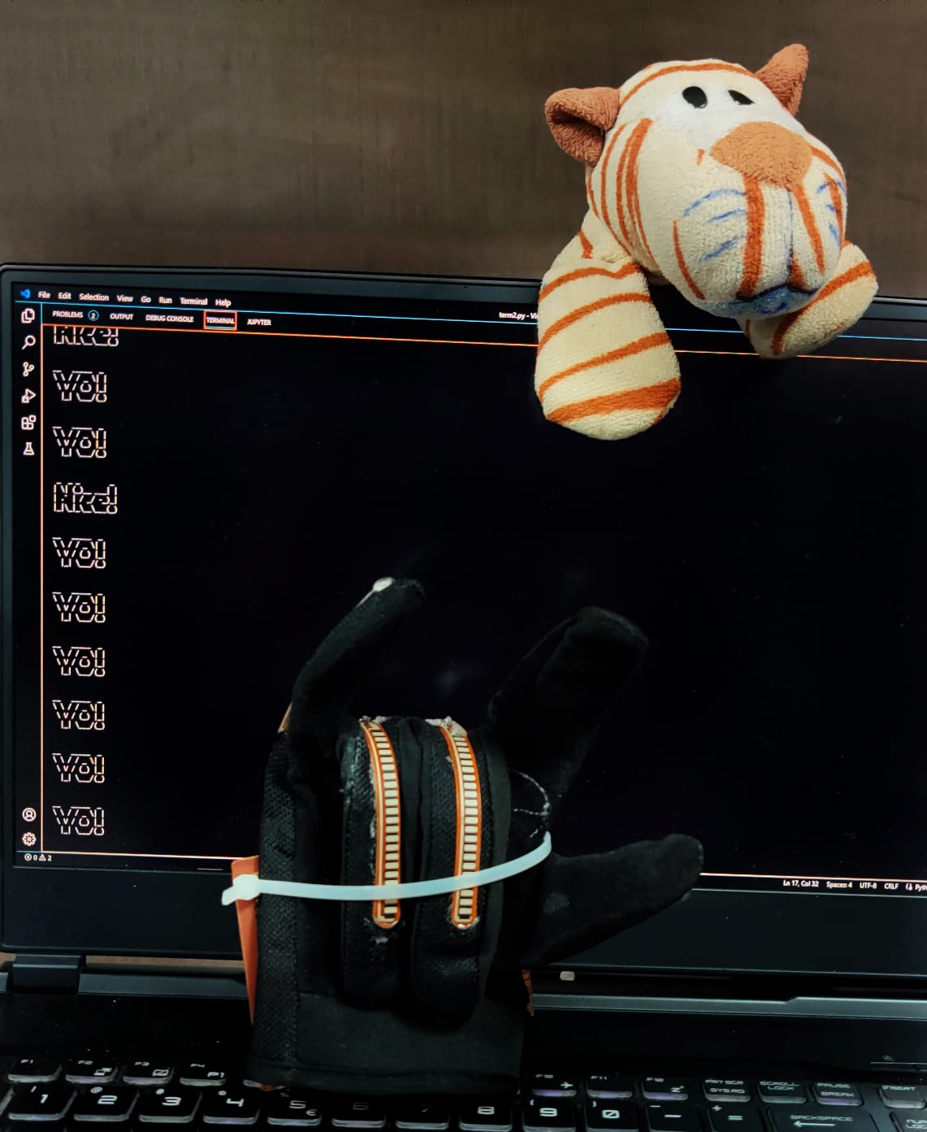
SOLUTION
A wearable glove that translates sign language into text and speech in real-time, can improve communication and integration of the deaf and hard-of-hearing community in society.
Notes:
Sohini

Slide 6
METHODOLOGY
Notes:
Sohini

Slide 7
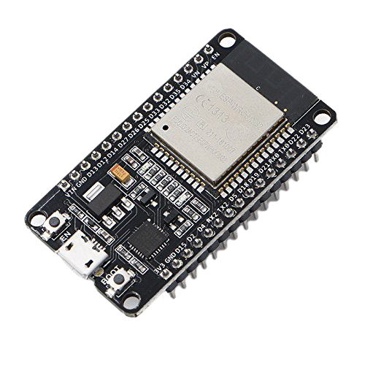
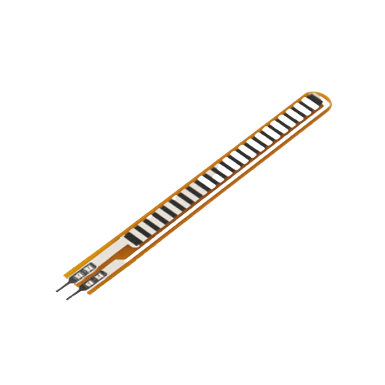
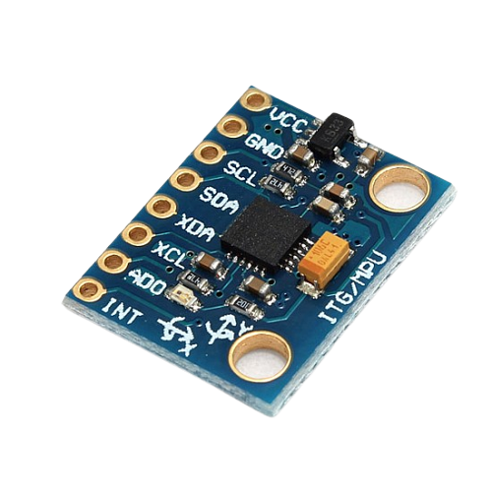
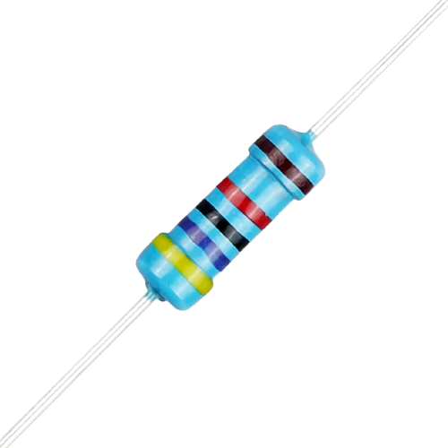
HARDWARE
ESP32 WROOM DA
FLEX SENSOR
Microcontroller Unit
2.2 Inch Flex Sensor for Bend Detection
MPU6050
RESISTOR
Accelerometer & Gyroscope Sensor
47kΩ Shunt Resistor for Flex Sensor
Notes:
Sohini

Slide 8
SOFTWARE
ANACONDA
Data Preparation & Model Training
ARDUINO IDE
Integrating MCU with Sensors and PC
PYTHON
Integrating Everything Together as a Final Terminal Application
PuTTy
Reading and Logging Data from Serial Monitor
Notes:
Shiro

Slide 9
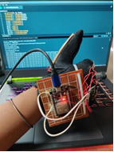
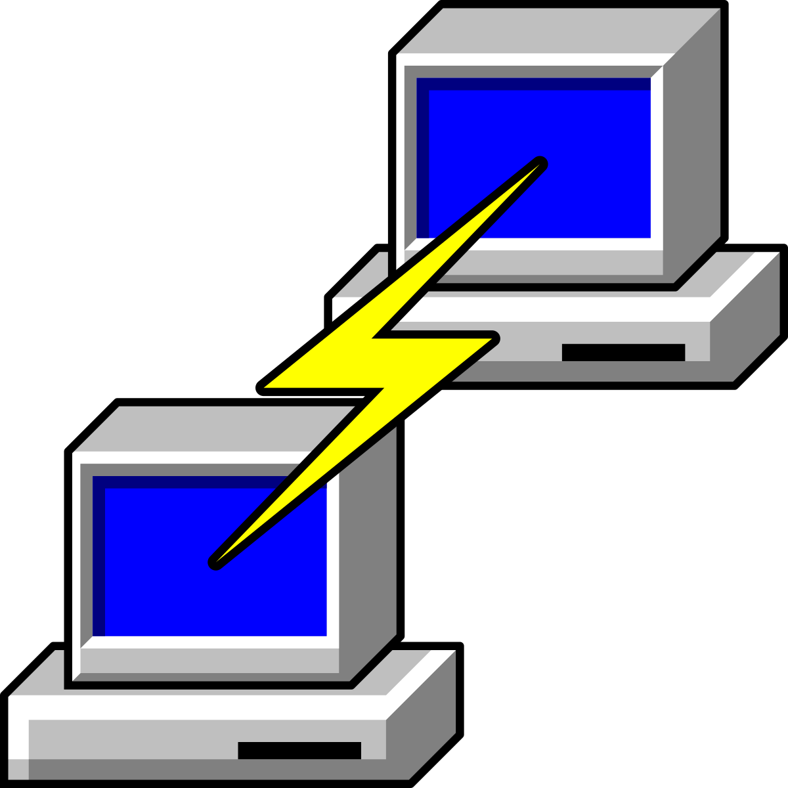
DATA COLLECTION
Initialize PuTTy on applicable COM Port with given Baud Rate
Record Data with Glove in the Gesture Position for a Set Amount of Time saved as log file
Repeat for Every Gesture
Notes:
Shiro

Slide 10
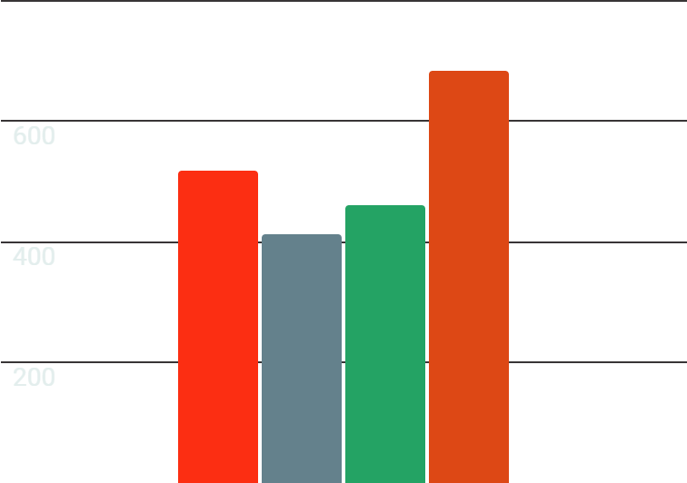
PREPROCESSING DATA
684
518
460
411
INITIAL
OK!
NICE
YO!
01
02
Removing Header Log Data
Converting to CSV
Notes:
Kota

Slide 11
FEATURE EXTRACTION
13 Features
Target Variable
Create 2 Separate Data Frames
Concatenating all Data Frames
Initially Different Data Frames for Different Gestures
1. 13 Features
2. Target Variable
Notes:
Kota

Slide 12
MODEL TRAINING
SCIKIT-LEARN
SPLITTING THE DATA
Test Data size = 12%
CREATING RANDOMFOREST MODEL
n_estimators = 30
TRAINING
THE MODEL ON DATA
TESTING
THE TRAINED MODEL
Notes:
Dobby

Slide 13
MODEL EVALUATION
99.99%
91.5%
 | PRECISION | RECALL | F1-SCORE | SUPPORT
YO! | 0.82 | 0.88 | 0.85 | 69
NICE! | 0.89 | 0.84 | 0.86 | 76
OK! | 1.00 | 0.98 | 0.99 | 51
STEADY! | 1.00 | 1.00 | 1.00 | 53
ACCURACY |  |  | 0.92 | 249
MACRO AVG | 0.93 | 0.93 | 0.93 | 249
WEIGHTED AVG | 0.92 | 0.92 | 0.92 | 249
Mean Accuracy on Training Data
Mean Accuracy on Test Data
Classification Report
Notes:
Dobby

Slide 14
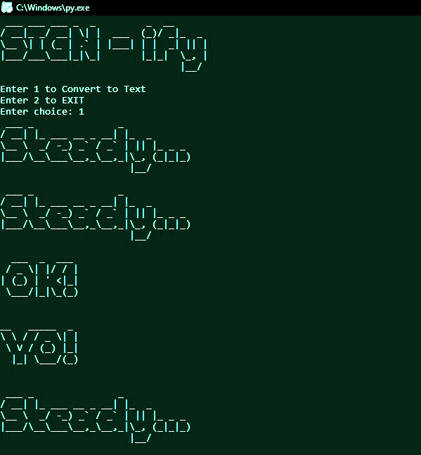
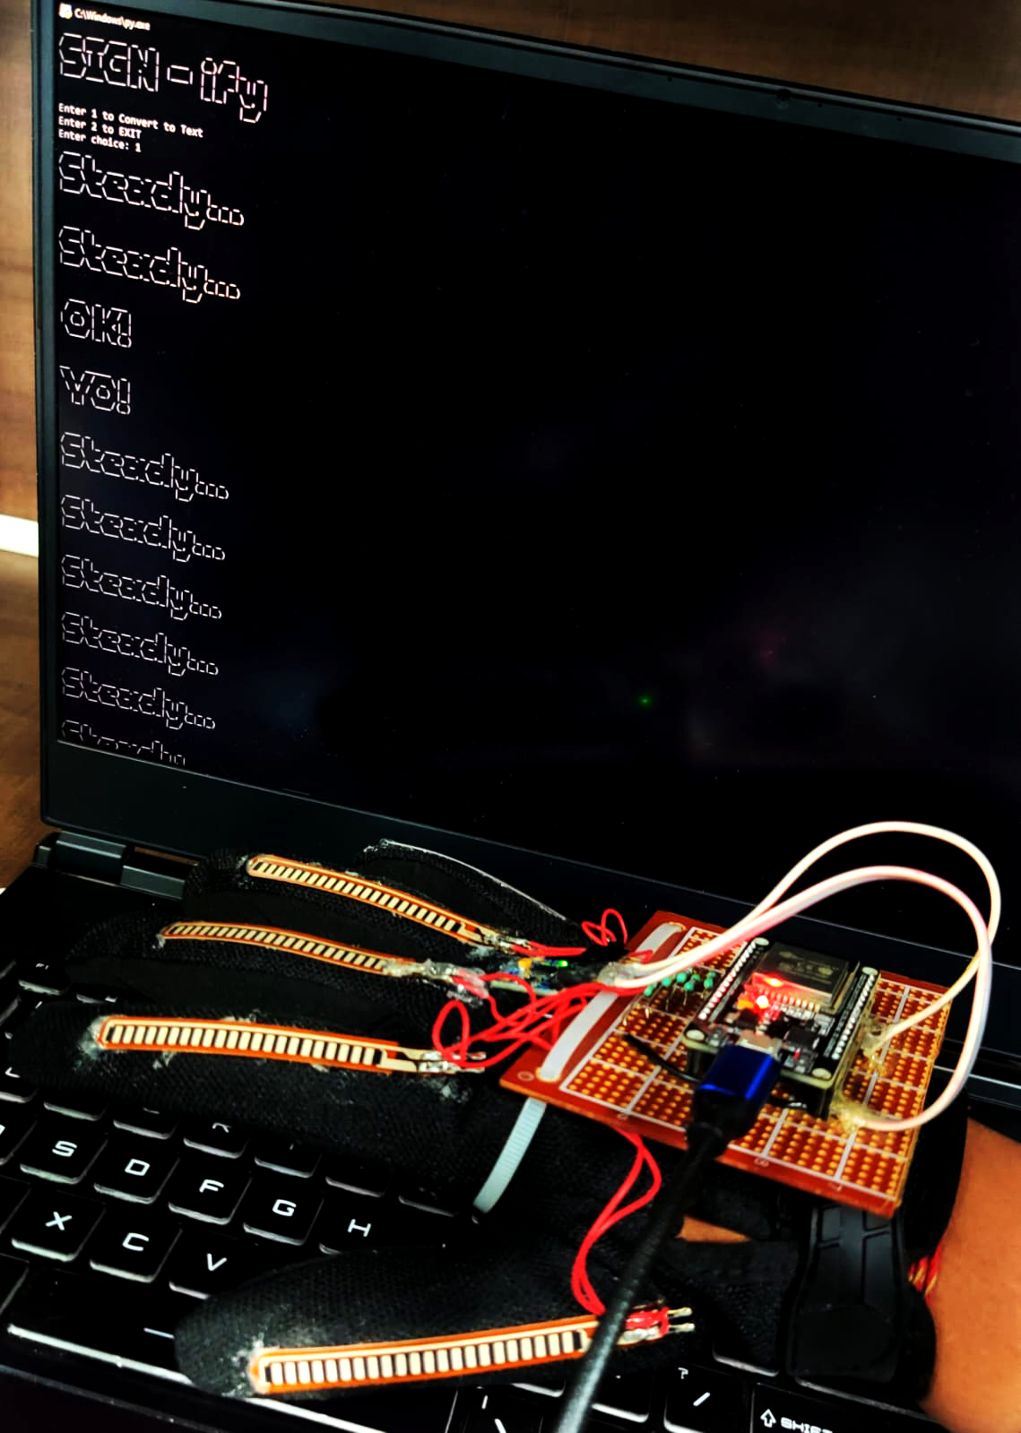
REAL-TIME TESTING
Notes:
Shiro

Slide 15
FUTURE SCOPE
Ease of use
Comfortable fit
Once the app is ready, one can easily use our device anytime anywhere without any other requirement but their phones.
We will be designing a custom PCB and mount it on a bendable veroboard made wristband for easy wear and comfort.
Expansion
Better
Understanding
We will be updating it with more gestures and alphabets and will be upgrading our MCU to fit and integrate everything perfectly.
We have planned to implement the use of AI to read the context of speech and thus translate the gestures accordingly for optimised meaning.
Notes:
Sohini

Slide 16
CONCLUSION
This project aims to bridge the communication gap between the deaf and hard-of-hearing community and the hearing community by developing a wearable glove that translates sign language into text and speech in real-time.
This device has the potential to revolutionize communication and improve integration of the deaf and hard-of-hearing community in society.
Notes:
Dobby

Slide 17
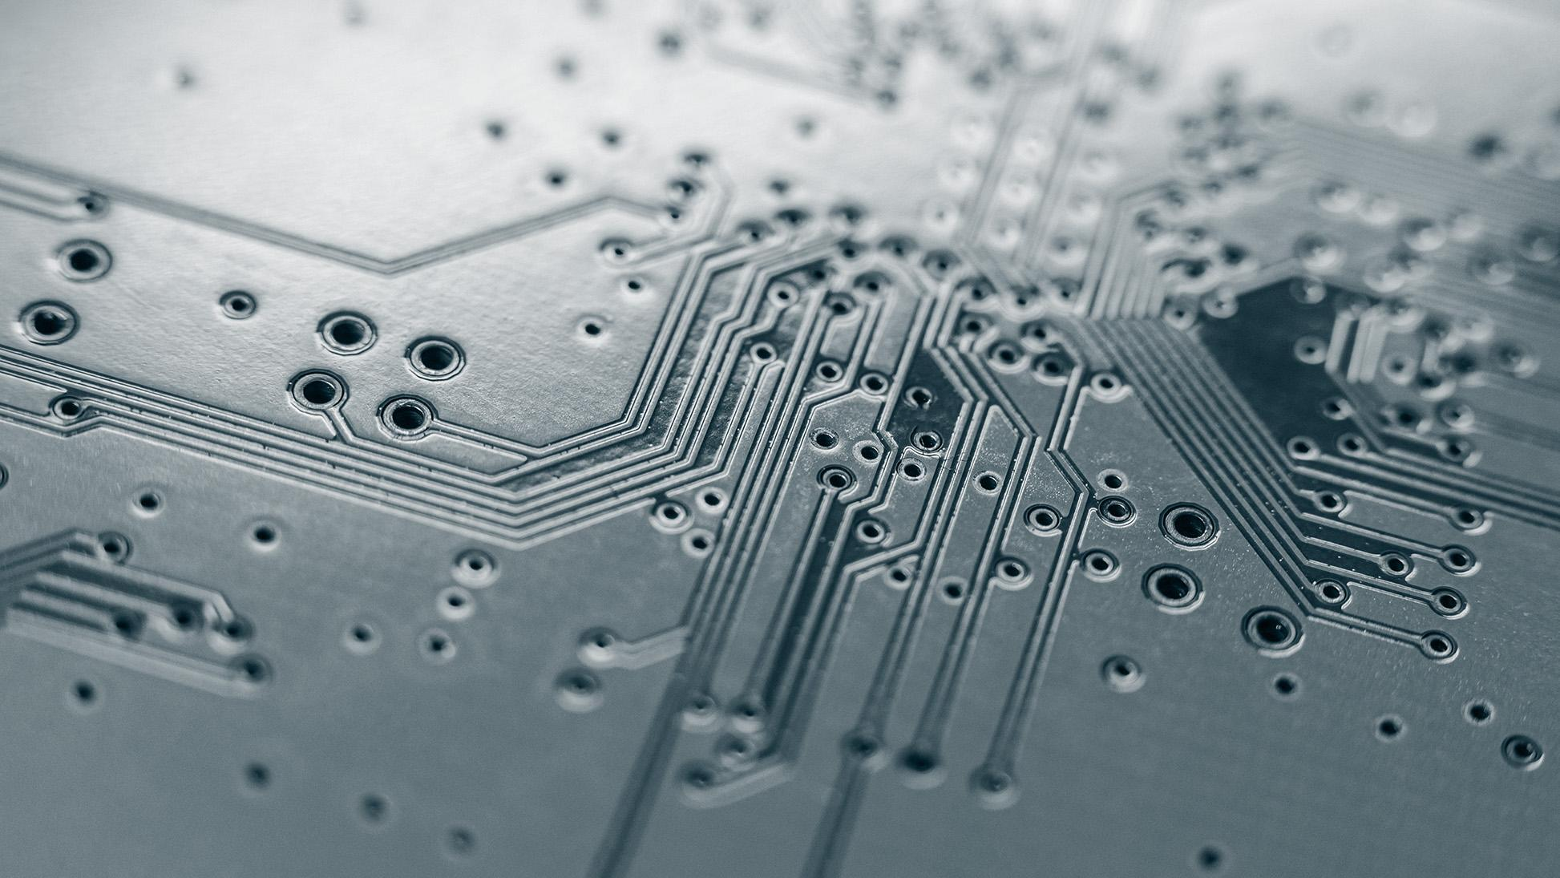

THANK YOU

Slide 18
Individual Contribution
Kishan Kumar Alok
||2005807||
Sohini Joarder
||20051108||
Shreya
Ved
||2005829||
Keshav Dokania
||2005520||
Machine Learning and Software Integration
Hardware circuitry and Application
Testing and Validation
Error Handling

Slide 19
WE ARE NOW OPEN
FOR QUESTIONS

